Slide 1
Data system for monitoring air quality Aarhus University Environmental Science (ENVS) Keld Mortensen
Agenda
Business and customers
Stations and instruments
Measured compounds
Dataflow
Data presentation. Internship 2016
Measurements in Greenland (Station Nord)
Available data
Finding dependencies between data

Slide 2
Business and customers
Authority service
EU <-> Ministry of Environment and Food <-> Aarhus University
Monitoring program : 120 mio/year
Air monitoring : 24 mio/year
Research projects
Private and Public fonds
Private service examples
Airport, Storebælt
Documents and data in dropbox
Notes:
2

Slide 3
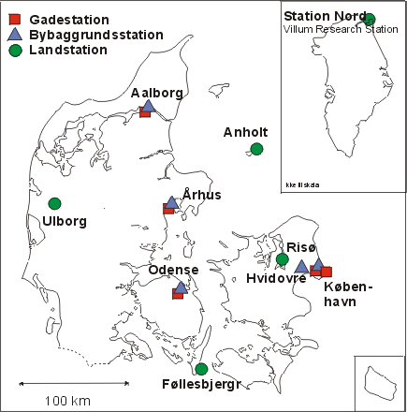
Stations and instruments
Notes:
3

Slide 4
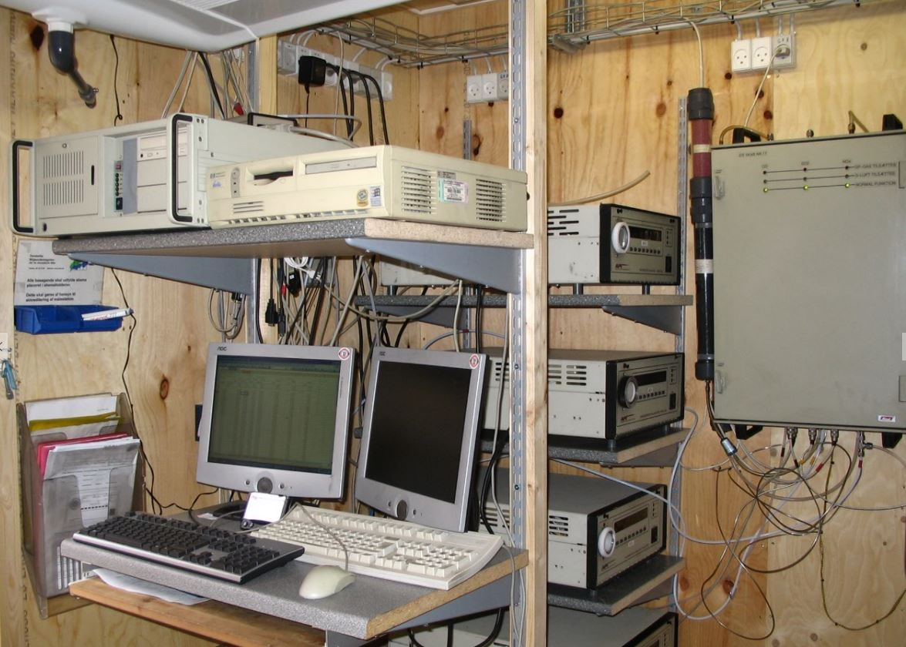
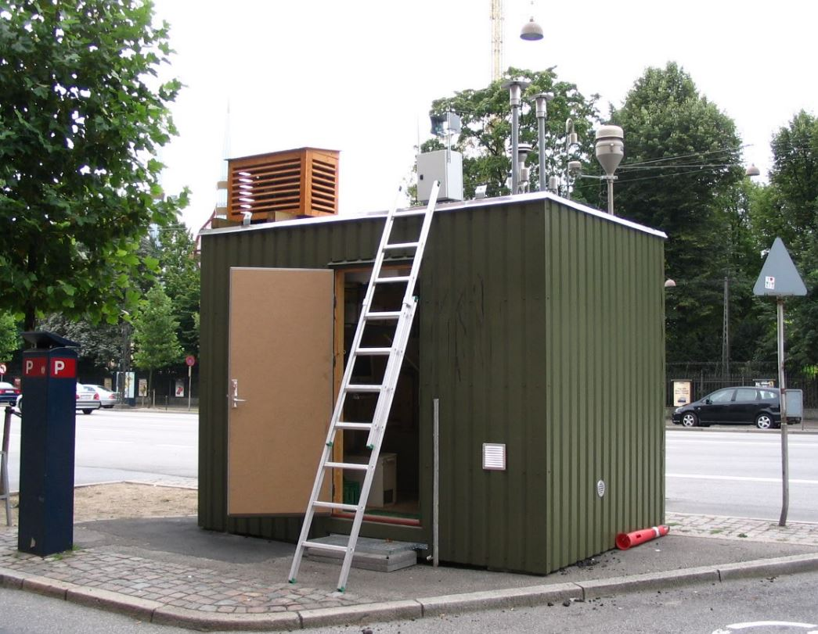
Stations and instruments
Notes:
4

Slide 5
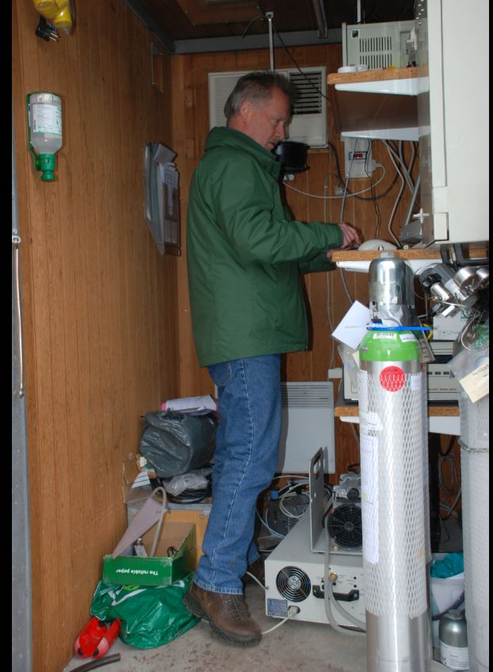
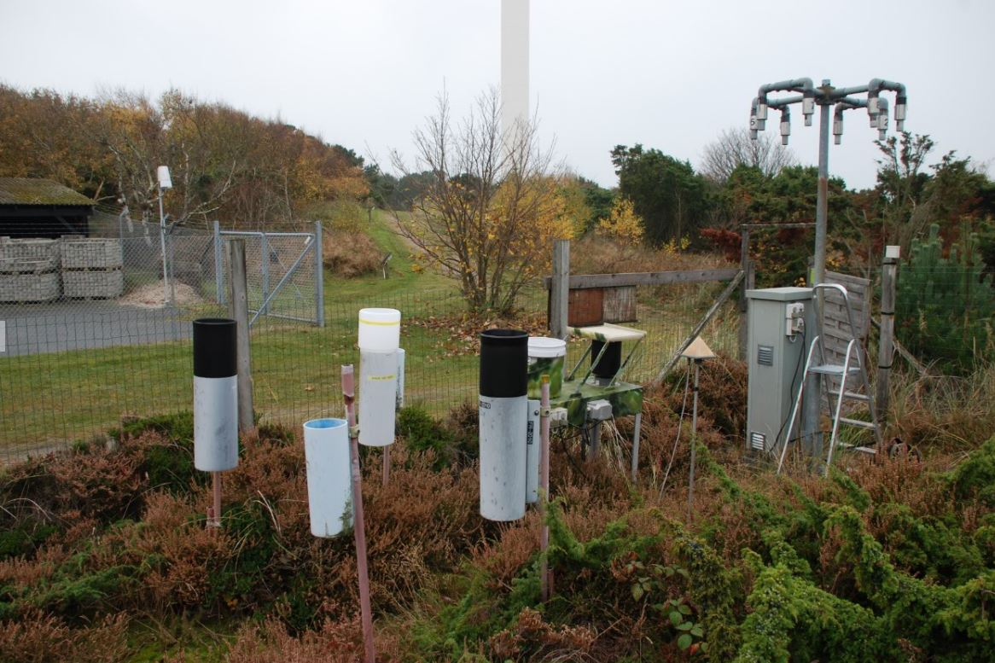
Stations and instruments
Notes:
5

Slide 6
Monitoring system
Integrated monitoring
Measurements, modelling and emissions
Online monitoring :
15 stations in Denmark
1 station in Greenland
Temporary stations
Precipitation and passive sampling
15 stations in Denmark
Notes:
6

Slide 7

Notes:
7

Slide 8
Measured compounds
Gasses (Ozone, Sulfur dioxide, Nitrogen oxides, Carbon oxides, Carbon dioxide, Methane)
Particles (Pm2.5, Pm10, Sizedistribution, Organic/Uorganic carbon, Heavy metals).
Organic compounds (PAH, Benzene, Dioxins, Pesticides)
Meterorology (Wind speed, Wind direction, Humidity,Temperature, Radiation,Precipitation)

Slide 9
Data flow
Samples (filters)
Stations
To laboratory
Samples (water)
Analyzes
Textfiles
3G/Iridium
File server
Data reporting
EEA
EMEP
Miljøstyrelsen (part of Environmental ministry)
Municipalities
Database
Quality control
Data presentation
Danmarks Miljøportal
AU Webserver
TextTV
Data exchange
Researchers
Students
Notes:
9

Slide 10
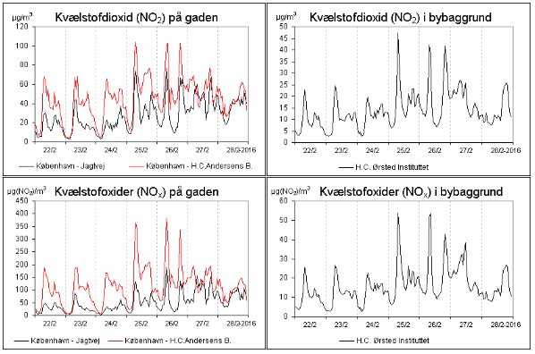
Datapresentation
Old system
Online data bases on static tables/graphs
Internship project 2016
Online data based on EF, MVC and WebAPI
Old system
Online data bases on static tables/graphs
Internship project 2016

Slide 11
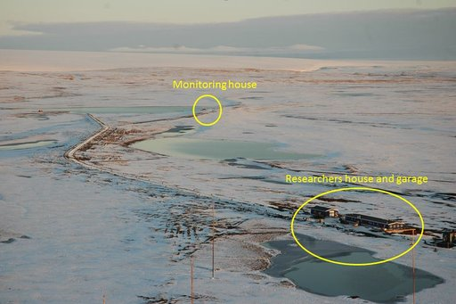
Villum Research Station, Station Nord
81º, 36’ N, 16º 40’ W

Slide 12
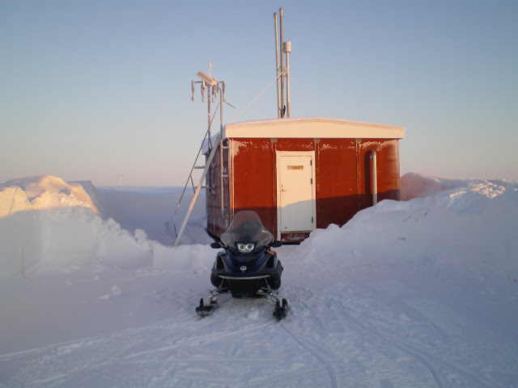
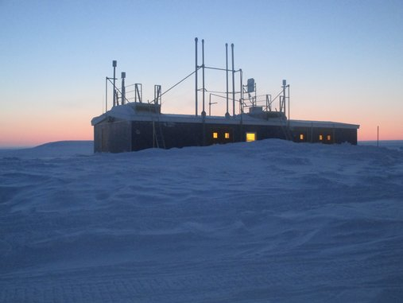
Measurements at Station Nord
Målinger 2015
Mercury, Ozon, Nitrogenoxides, Carbonmonooxid, Soot, Particles, Particlesize, Filterpack (SO2,SO4,NO3,NH4), Organic compounds, Clorinated compounds, Perfluorcarbon, Pesticides, Bromine, Greenhousegases (CH4,CO2), Meteorologi (Windspeed,Winddirection,Temperature,Humidity,Radiation,Albedo), Precipitation, Clouds.
Villum Research Station, metadata

Slide 13
Available data
Temperature in the station (degrees and humidity inside the station)
Mercury (heavy metal ng/m^3)
Ozone (O3 ppb)
Particlesize and volume (number/cm^3, volume in cm^3)
Flow in inletsystem (m^3/hour)
Ambient temperature (degrees outside)
Windspeed (m/s)
Winddirection (degrees)
Radiation (W/m^2)
Relative humidity (% outside and inside)
Precipitation (mm)
Link to data

Slide 14
Find dependencies in data
Mercury and Ozone
Mercury and ambient temperature
Solar radiation and particle numbers/volume
Humidity and particle numbers/volume
Inlet flow and Mercury and/or Ozone koncentrations
Vindspeed and temperature
Precipitation and particle numbers

Slide 15
Some usefull links
Aarhus Universitet
Institute for Environmental Science
Air Quality Report 2015
Air Quality Directive (EU)
Air Quality Limits (EU)
Near online data, Internship Near Online site
Danmarks Miljøportal
Station Nord meteorology online
Data and documentation for you:
Link to XML data from Greenland Station Nord (2014-17)

